Slide 1
2014 VVV Reunion
Portraits

Slide 2
Michelle and Mike Alexander, hosts

Slide 3
Shirley and Jerry Beasley hosts

Slide 4
Connie and Paul Bugos Connie is the outgoing president

Slide 5
Bruce and Linda Vawter Bruce is now VVV President

Slide 6
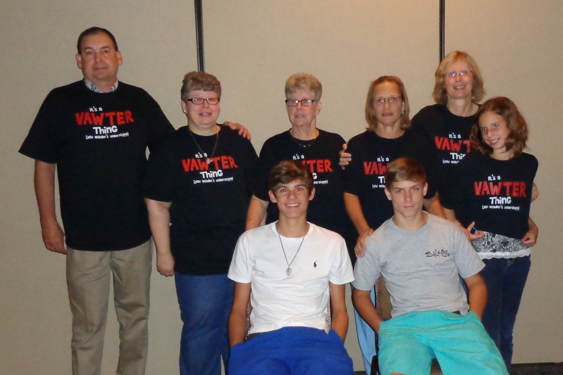
Sue Vawter and family Renee, Danny and Kailey Chaviers, Melinda Vawter, Cindy, Matthew and Jacob Landry
The 2014 VVV Reunion was dedicated to
John Homer Vawter Jr. and
J W (John Wesley) Vawter,
Both Past Presidents of the VVV
and both passed away in 2013.

Slide 7
Georgene Jurgensen

Slide 8
Phil Vaughter

Slide 9
Roger Wicker

Slide 10
George Wicker and Fred Wicker

Slide 11
Ken and Norma Wicker

Slide 12
Ellen and Ned Cummings

Slide 13
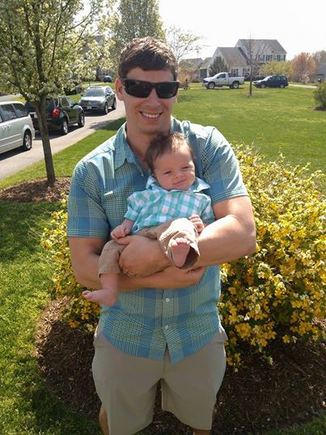
Becca Cummings Frederick Cummings and Stafford Cummings These copied from facebook, since Stafford went to bed early.

Slide 14
Becky and Barry Guinagh

Slide 15
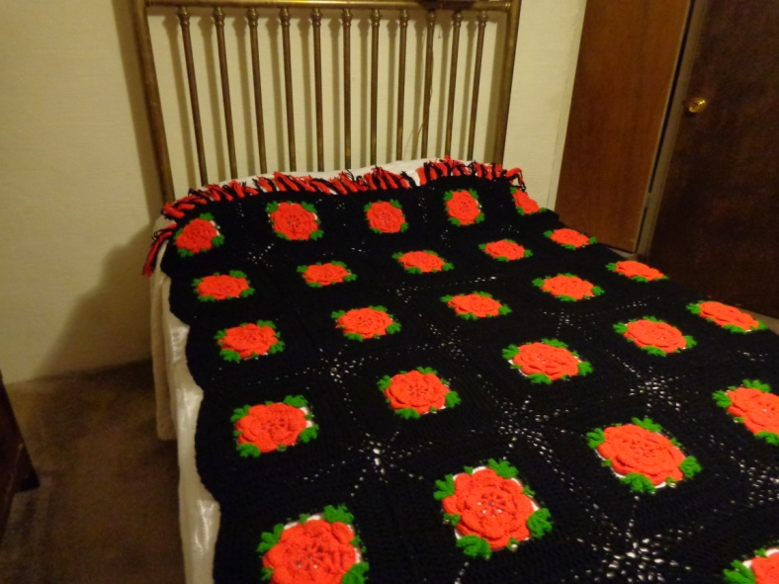
Martha Hudson and great granddaughter Elizabeth Hale (notice the background)
Martha brought the beautiful
handmade afghan in honor
of her sister Judith Crawford
who passed away last August.
After the auction, the proud
owner is Patricia Renton,
thanks to her son, Jordan Johnston.

Slide 16
Tommy Hudson

Slide 17
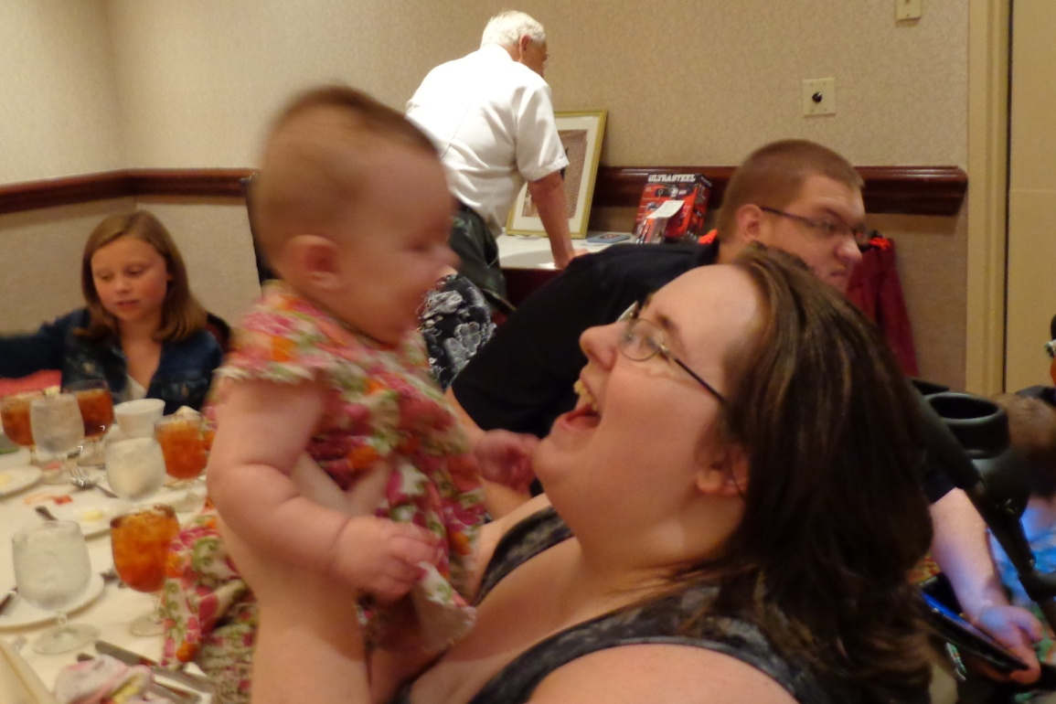
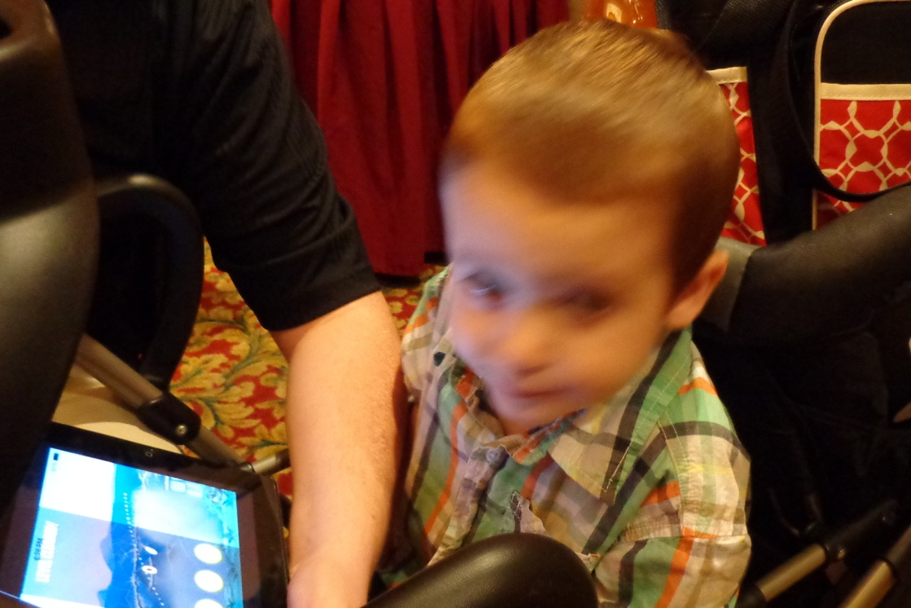
Jackie Hudson Smith Corinne and Ian Smith

Slide 18
Robert L Vawter Sr and Garry Vawter

Slide 19
Bob and Linda Vawter

Slide 20
Bonita and Joe Welch

Slide 21
Darren Welch and Anna Welch Darren is now Vice President of the VVV

Slide 22
Pam Elsass came for part of the reunion

Slide 23
Patty and Greg Robinson came for part of the reunion

Slide 24
Jason Vawter Krista Cheek and Lilah Vawter

Slide 25
Jordan Johnston, Patricia Renton, Luke Williams

Slide 26
Press ESC to return to the menu

